Slide 1
CS 4530 Software Engineering
Module 17: Open Source Principles
Jonathan Bell, Adeel Bhutta, Mitch Wand
Khoury College of Computer Sciences © 2022 released under CC BY-SA

Slide 2
Learning Objectives for this Lesson
By the end of this lesson, you should be able to…
Understand the terminology “free software” and explain open source culture and principles.
Express an educated opinion on the philosophical/political debate between open source and proprietary principles.
Reason about the tradeoffs of different open source licenses and business model

Slide 3
In the beginning, there was Open Source
Hardware was not yet standardized, computer vendors focused on hardware innovation, building new operating systems for each platform
Much software development focused in academic labs, and AT&T’s Bell Research Labs
Unix created at Bell Labs using the new, portable language “C”, licenses initially released with source code
IBM 704 at NASA Langley in 1957 (Public domain)
Notes:
HW not standardized -> OS’ were written in assembly (no higher level language was efficient enough, and hardware was too slow).
Academic -> already have culture of open science
Bell labs -> 1949 US DOJ starts antitrust investigations into ATT (who at the time owned every single aspect of the phone system from the device in your home to the wires in your wall to the wires on the street, across the country, switching equipment, etc - no other providers involved), 1956 US enters Korean War and DOJ and ATT agree on a “consent decree” to end the investigation and help ATT focus on war effort. Consent decree said that ATT couldn’t enter new telecommunications businesses. As a result, ATT determines that they could not “pursue software as a business” and they ended up needing to release the source code with the operating system so that end-users could implement bug fixes etc. on their own (no ability to do service contracts).

Slide 4
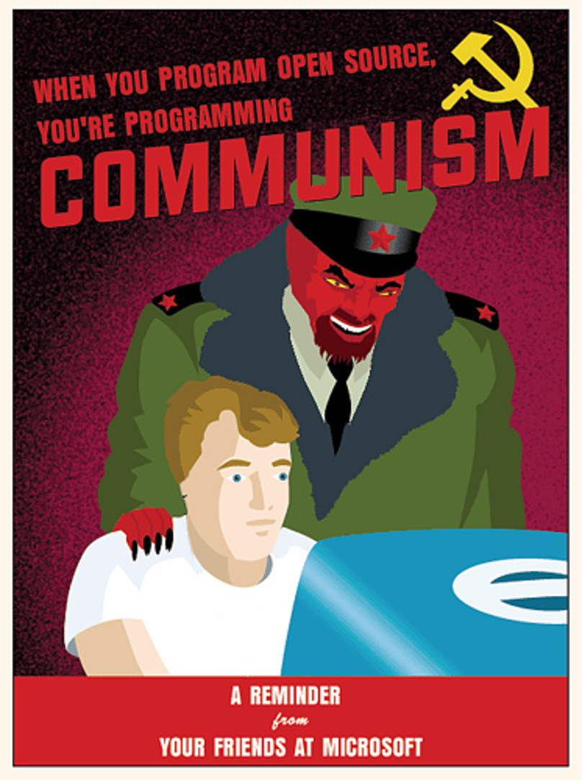
The Case Against Open Source
“Open-Source Doomsday”: Once all software is free, we’ll stop making more software and have a market collapse
Innovation will be stifled by the risk that software will be copied
Making source code public means easier to attack
“Anarchistic” licensing prevents companies from profiting from open source software
[Variation of popular meme, original source unknown]

Slide 5
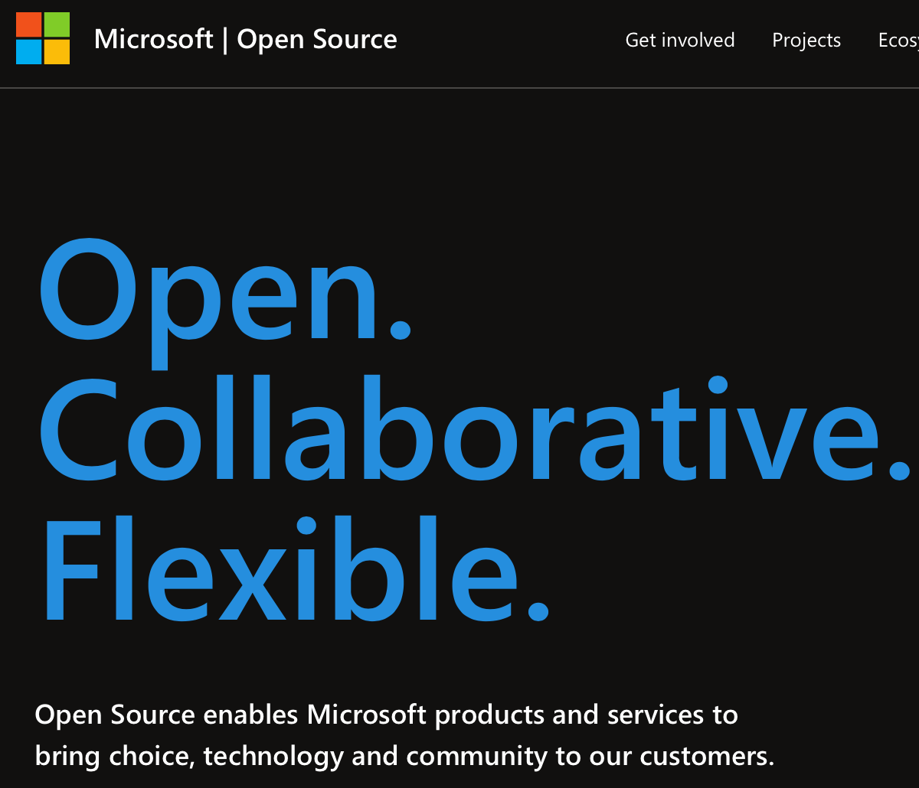
The Case For Open Source
Many eyes make all bugs shallow
End-users can improve and customize software to their needs
New features can be proposed and developed organically
Greater productivity when more code is reused (easier with open source)
[Screenshot, 2022, opensource.microsoft.com]

Slide 6
UNIX, BSD and GNU
BSD Copyright in OS X boot sequence
1978: UC Berkeley begins distributing their own derived version of Unix (BSD)
1983: AT&T broken up by DOJ, UNIX licensing changed: no more source releases
Also 1983: “Starting this Thanksgiving I am going to write a complete Unix-compatible software system called GNU (Gnu’s Not Unix), and give it away free to everyone who can use it”
GNU logo (a gnu wildebeest)
Notes:
Let’s return to our starting point, then: UNIX.
BSD -> big legacy: screenshot on top is from boot sequence of Mac OS X… note the “copyright regents of the university of California”
1983 - Everything was pretty peach with AT&T’s Unix being used and improved in academia until 1983… when DOJ settled a new antitrust case against ATT, ATT then breaks up into the “baby bells” (regional operating companies like bell Atlantic; most of these are now verizon), meaning the ATT can now commercialize UNIX, which they do.

Slide 7
Free Software as a Philosophy
“Free as in Speech, not as in beer”
Although UNIX was distributed to licensees with source code, the license was still restrictive
Richard Stallman’s Free Software Foundation - free as in liberties
Freedom 0: The freedom to run the program as you wish, for any purpose
Freedom 1: The freedom to study how the program works, and change it so it does your computing as you wish
Freedom 2: The freedom to redistributed copies (of the original) so you can help others
Freedom 3: The freedom to distribute copies of your modified version to others
Richard M Stallman (Licensed under GFDL)
Notes:
An interesting and important outcome of this fracture was Stallman’s writings and creation of the free software foundation, which holds fast to these principles of software liberties..
(read slide)
Discuss: how is it possible to actually build a product and follow these freedoms? What is there to stop someone from taking your software, improving it, and selling it? (Next slide describes the “fix” for this with copyleft)
Discuss: What kind of person is RMS for starting the freedoms with 0?

Slide 8
Free Software as a Philosophy
“Free as in Speech, not as in beer”
Free Software Foundation: Free software should be licensed under the GNU Public License (GPL), considering questions like:
Are you required to redistribute any modifications (under same license) - “copyleft”
Can you redistribute executable binaries, or only source?
Are you allowed to use the software in a restrictive hardware environment? (“Tivioization”)
Popular alternative: “Do whatever you want with this software, but don’t blame me if it doesn’t work” (“freeware”)
Notes:
FSF & Stallman apply this philosophy to an extreme.
The TiVo thing is silly because TiVo ended up basically dying off anyway (perhaps related to this decision): They created hardware that ran linux, but ONLY their linux, you couldn’t modify linux then flash it onto their device - the hardware checked for signatures. This is prohibited under GPLv3 (created as a response to TiVo’s move), but was permitted under GPLv2 (which linux is still licensed under). Probably many reasons for TiVo’s demise, but the lack of software innovation is probably related…

Slide 9
GNU/Linux (1991-Today)
Stallman set out to build an operating system in 1983, ended up building a tremendous set of utilities that are needed by an OS (compiler, utilities, etc)
Linux is an operating system built around and with the GNU utilities, licensed under GPL
Rise of the internet, demand for internet servers drives demand for cheap/free OS
Companies began adopting and supporting Linux for enterprise customers - IBM committed over $1B; Red Hat and others
Notes:
In the 90’s you COULD download linux for free, but what was even more popular was sending away for it on disks, paying only for the cost of the disks themselves and postage - think $6 instead of $150 for windows

Slide 10
The Cathedral and the Bazaar (1997)
Eric S Raymond’s 1997 essay compares software development methodologies as a “cathedral” or “bazaar”
Much OSS today follows this “bazaar” model:
Users treated as co-developers
Release software early for feedback
Modularize + reuse components
Democratic organization
Notes:
Part of Linux’s successes and growth in the 90’s is captured in Eric S. Raymond’s 1997 essay “The cathedral and the bazaar”
Cathedral (closed source) - Top-down design with focus on planning
Bazaar (open source)
Organic bottom-up movement
Code always public over internet

Slide 11
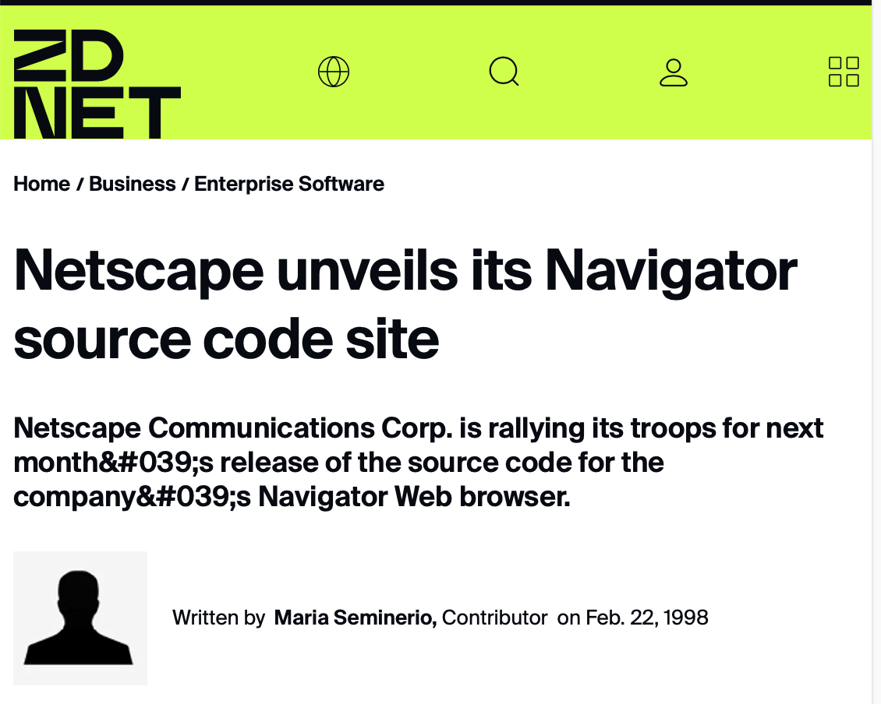
Netscape: “Collaborating with the Net”
Netscape was the dominant web browser in the early 90’s
Business model: free for home and education use, companies paid to use it
Microsoft entered browser market with Internet Explorer, bundled with Windows in 1995, soon overtakes Netscape in usage (it’s free, with Windows!)
January 1998: Netscape becomes first (?) company to make source code for proprietary product open (Mozilla)
Usage Share of Netscape Navigator
Notes:
Lots of interesting details about netscape’s decision and process here - https://www.oreilly.com/openbook/opensources/book/netrev.html . Perhaps most interesting to discuss is the process around deciding the license (they used a public, somewhat democratic process to determine what licensing constraints should be). The vision was truly to “collaborate” with everyone building and using the web, rather than to try to create a singular ideal product (which is what they had previously been doing, and Microsoft beat them at)
Netscape did not call this open source!!!! They released a public website with their source code (“open source” was not yet coined)

Slide 12
“Open Source”
Until Netscape/Mozilla, much of open source movement was concentrated in the free software foundation and its GPL
“Open Source” coined in 1998 by the Open Source Initiative as a term to capture Netscape’s aim for an open development process, Eric Raymond’s “Bazaar”
Publisher Tim O’Reilly organizes a “Freeware Summit” later in 1998, soon rebranded as “Open Source Summit”
“Open Source is a development methodology; free software is a social movement” - Richard Stallman
Open source initiative logo
Tim O’Reilly Photo via Christopher Michel/Flickr, CC BY 2.0
Notes:
Coining and protecting the term “open source” was a big deal for getting to the open source that we know of today. (Slide largely explains how term was coined, focusing on last quote might provide good opportunities for discussion).
Discussion ideas:
Stallman’s quote comes from an essay titled “Why Open Source Misses the Point of Free Software” - do you think that the proponents of open source did this intentionally (the answer is yes: they want something that was a development methodology that could be seen as palatable and adopted by businesses, governments, and those who may not agree with the social movement)
These movements are clearly motivated by the backgrounds and goals of their founders. Tim O’Reilly is a book publisher. Richard Stallman is an anarchist hacker (his direct quote is that it combines aspects of capitalism, communism and anarchism).

Slide 13
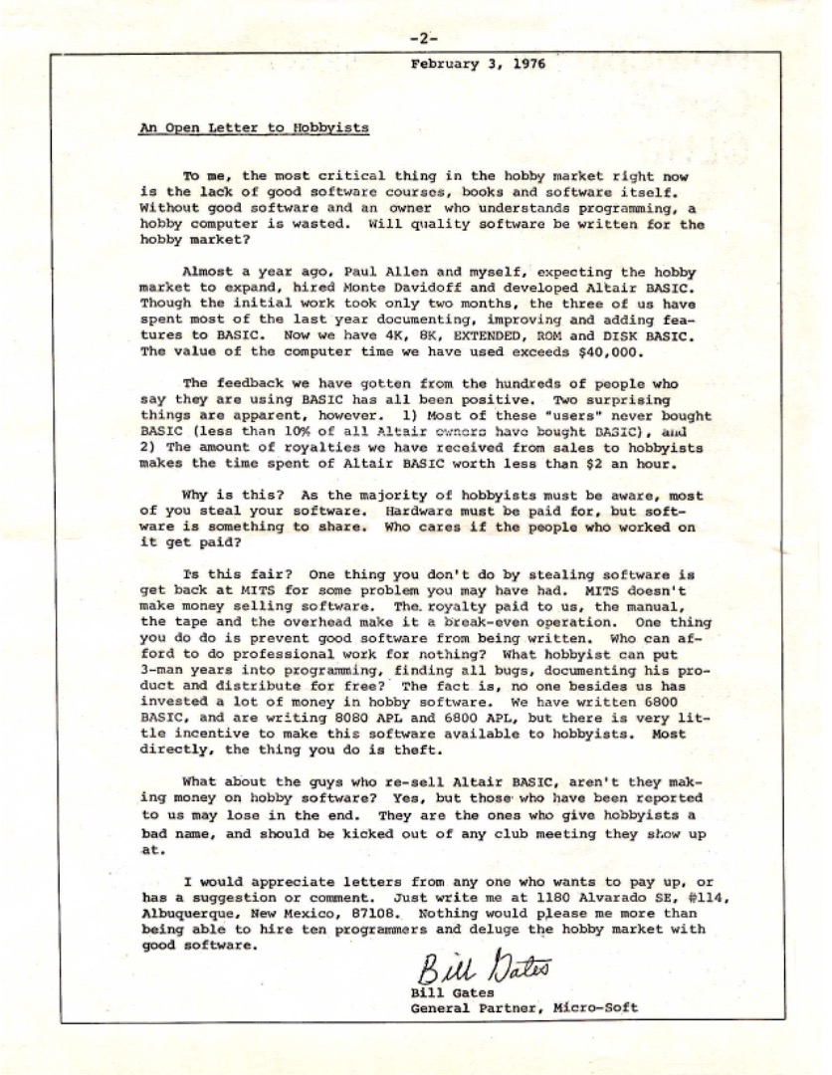
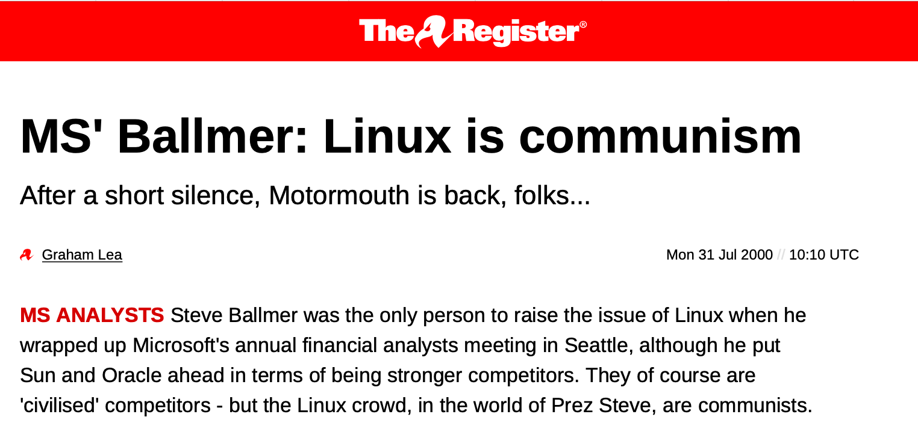
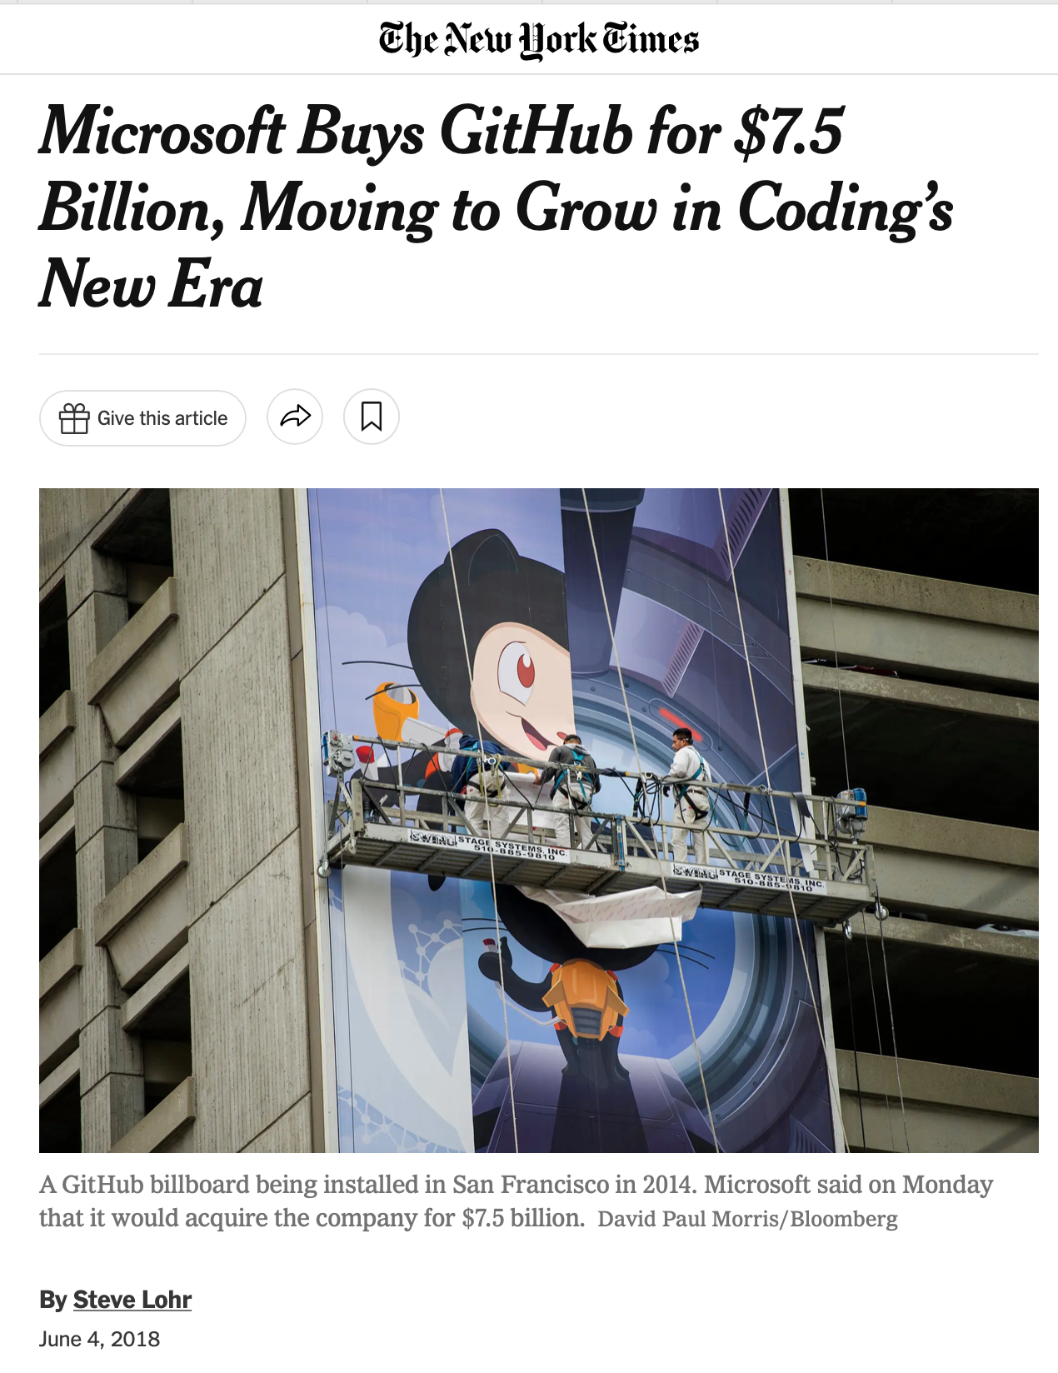
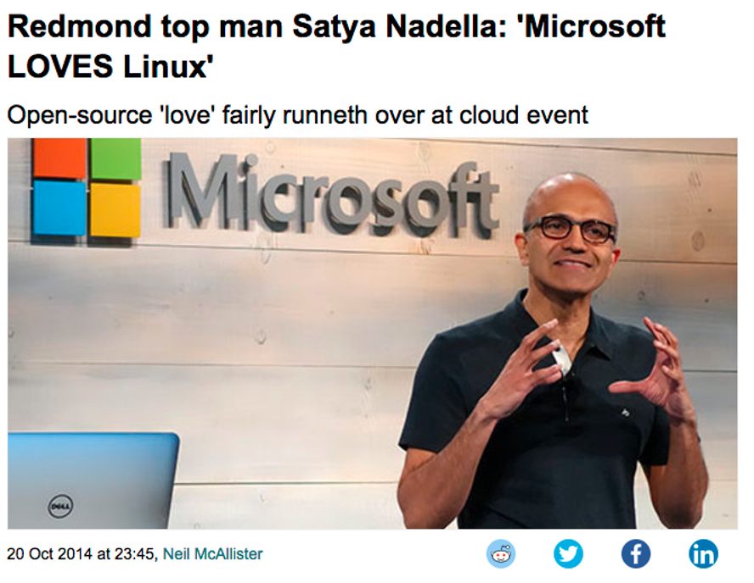
Is Open Source a Good Business Model?
Notes:
As we’ll discuss in this lecture, there is no single answer to the question “is open source a good business model”, and instead, it is probably more useful to talk and think about different contexts and different business models - and then think about the role of open source in that business.
As a teaser to indicate how the role of open source in software development can shift over time:
In 1974 Bill Gates wrote an infamous open letter to hobbyists who were using his Altair 8800 BASIC interpreter without a license. They were stealing his software, and it didn’t work with the business model of micro-soft.
Cut to 2000, when in an earning’s call, the then-CEO Steve Ballmer stated that it had “the characteristics of communism that people love so very, very much”
Cut to 2014, when Microsoft’s new CEO announces that “Microsoft LOVES Linux” and starts invest in it. And 2018 when for 7.5b they bought GitHub, plus much more.
There is, perhaps, some way to do this right and many to do it wrong.

Slide 14
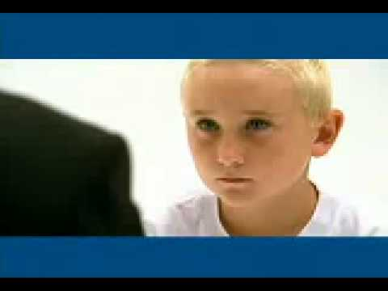
IBM TV Commercial: “Prodigy”
https://www.youtube.com/watch?v=x7ozaFbqg00
Notes:
Watch commercial. Discuss reactions: what is the vision that IBM is trying to convey? How do you monetize this vision?

Slide 15
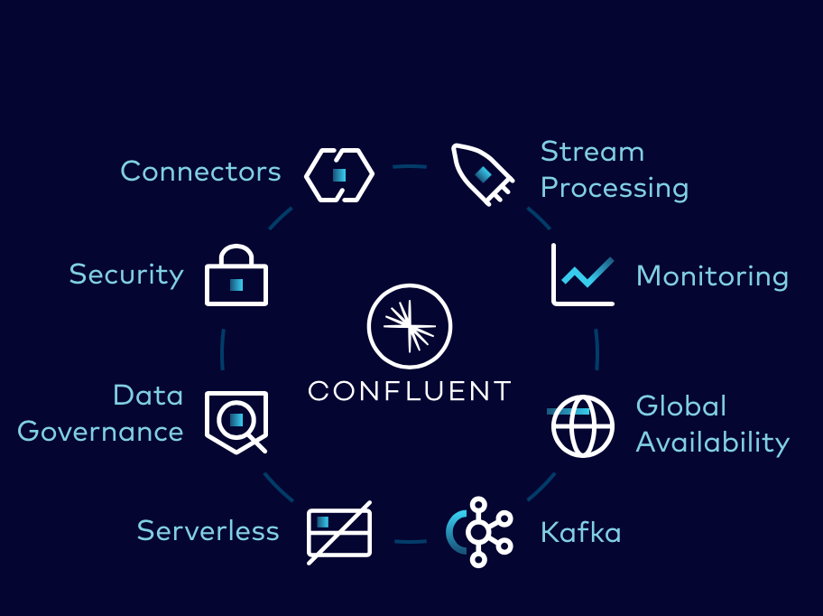
Model: “Open Core,” closed plugins
Model: core component of a product is an open source utility; premium plugins available for a fee
Example: Apache Kafka, a distributed message broker (glue in an event-based system)
Product is open source, maintained by Apache foundation, supported by company “Confluent”
Confluent provides plugins to connect Kafka to many different systems out-of-the-box
[Screenshot: “Apache Kafka vs Confluent”]

Slide 16
Model: Open Source as a Utility
The largest, most successful open source projects implement utility infrastructure:
Operating systems, web servers, logging libraries, programming languages
Business model: build and sell products and services using those utilities, contribute improvements back to the ecosystem
Many companies provide specialized “distributions” of these open source infrastructure and specialized tools to improve them; support the upstream project
Notes:
Example: bank needs to have servers, bank might need to have linux. Does bank have staff to support and patch linux, or do they pay someone for a service contract? They pay Red Hat (recently purchased by IBM, about 20 years after that ad was made).
We all love and hate Java; we probably use IDEs from JetBrains ,who also is involved in the ongoing maintenance of java, and created the JVM-compatible language, kotlin
Discussion: Are there other projects that you can think of that are open source, and not really what the company who created them does? How do those companies (in)directly profit from this?
React (Facebook is a social network, but created and maintains an app toolkit) - profits from apps that integrate with their network
Square, many other small-ish tech companies open source their dev tools and libraries - helps with recruiting?

Slide 17
The Open Source Browser Wars
Firefox (based on Mozilla, based on Netscape) is no longer dominant: Chrome and Safari are
Chrome’s core: Chromium (open source)
Safari’s core: Webkit (open source)
Microsoft’s IE successor, Edge? Based on Chromium
How do browsers differentiate themselves, and why is there still more than one?
[By Datavizzer, CC BY-SA 4.0]

Slide 18
Where do laws come to play in open source?
Copyright provides creators with protection for creative, intellectual and artistic works - including software
Alternative: public domain (nobody may claim exclusive property rights)
Trademark protects the name and logo of a product
Open source software is generally copyrighted, with copyright retained by contributors or assigned to a foundation/corporation that maintains the product
Copyright holder can grant a license for use, placing restrictions on how it can be used (perhaps for a fee)
Common open source licenses: MIT, BSD, Apache, GPL
Notes:
…. The most relevant distinctions between the licenses are whether they include a term called “copyleft” (next slide)

Slide 19
Licensing: Copyleft vs permissive
Can I combine some open source software with my product, releasing my product under a different license (perhaps not even open source)?
Permissive licenses encourage adoption by permitting this practice
Copyleft “protects the commons” by forcing all linked code to be released under same license (e.g. GPL)
Philosophy: do we force participation, or try to grow/incentivize it in other ways?
Notes:
Discuss: what are the benefits to each approach?

Slide 20
Model: Dual Licensing
Offer a free copyleft (e.g. GPL) license to encourage broad adoption, prevent competitors from improving it without sharing those improvements.
Offer custom, more permissive licenses to third parties who are willing to pay for that (e.g. enterprise)
Only possible when there is a single copyright owner, who can unilaterally change license
Risk of losing control of the copyleft portion: nothing to stop the community from forking it
Examples: MySQL, Qt
Notes:
This approach runs into interesting philosophical questions:
From the FSF perspective: it is immoral to contribute to mysql, because mysql will profit from your contribution
Is this the kind of democratic “bazar” that we started with, or is it just a facade of “real” open source?
When Oracle bought MySQL (as part of buying Sun), the community fractured and created MariaDB, a fork of MySQL that is released under GPL (nothing in GPL to stop that from happening, it’s kinda the point of GPL)

Slide 21
Model: Hosted Open Source Products As A Service
Model: Creators of open source software provide a cloud hosted, “fully managed” installation of the software, as a service
Risk: What is your competitive advantage over cloud utility providers e.g. Amazon?
Amazon could even make improvements to your GPL code and not have to share them because it is not distributing the program (it operates it as a service)
Example: MongoDB Atlas (document-oriented database)
MongoDB created a new license to require copyleft for service providers operating MongoDB as a service
Amazon created their own fork of the GPL’ed version of MongoDB

Slide 22
Successful Open Source Projects Have Strong Communities
Open source projects thrive when the community surrounding them contributes to push the project forwards
Communities form around collective ownership (even if it’s only perceived)
Contributors bring more than code: also documentation, support, and outreach
Community/ownership models:
Corporate owner, community outreach/involvement (MySQL, MongoDB)
Foundation owner, corporate sponsors (GNU, Linux)
Notes:
Discuss benefits/risks of different models:
Corporate ownership
Easier to set a vision/strategy/path
Might lose the community support
Needs to provide some financial benefit to company
Foundation ownership
Organization of foundation might influence how hard it is to make decisions: consider benevolent dictator for life (e.g. Guido Von Rossum + Python; Larry Wall + Perl) vs democracy
Needs to find some way to keep community engaged (or it falls apart)

Slide 23
When communities move on: Forks
When software is released under an open source license, the only rights that the creator can realistically retain are trademarks on name/images - code can otherwise be “forked”
Example:
Sun bought StarOffice in 1999, GPL open-sourced as OpenOffice in 2000 with aim of fighting MS Office
2010: Oracle buys Sun, fires many internal developers, frustrating external community
2011: Community forms a foundation, creates fork LibreOffice, OpenOffice dies off (Oracle transfers to Apache)
Notes:
LibreOffice was heralded as “an effort to duplicate the strategy used by Netscape’s Mozilla open-source spinoff”

Slide 24
Java: Open Source to Retain Control
While the Java specification is public, there was no open source Java runtime
Much open source software was/is written in Java, creating “The Java Trap” for open source
1996-2006: GNU, Apache (backed by IBM and Apple), and others attempted to create open source implementations; Sun refused to permit these runtimes to be tested for compatibility, prohibiting them from using the term “Java”
2007: Sun releases OpenJDK under GPL; third party projects abandoned mostly uncompleted
Notes:
Java has an interesting history. While there has long been a “java community process”, the extent to which the community is engaged in its design, development and evolution.
https://www.gnu.org/philosophy/java-trap.html
https://danesecooper.blogs.com/divablog/2006/11/the_people_who_.html

Slide 25
Android: Build the Ecosystem, not the Operating System
Model: “Product” is the ecosystem (app store, ads, etc) and the hardware (made by competing manufacturers), not the operating system
Android is entirely open source, built on Linux; applications are written in Java, executed using a custom-built runtime
To provide implementations of core Java APIs (e.g. java.util.X), Android used the open source Apache Harmony implementations
Oracle v Google: Oracle asserted that Java APIs were their property (copyright) and Google misused that; judge ruled that could not copyright APIs
Notes:
(Why didn’t Android use OpenJDK from day 1? Because Android predated OpenJDK; OpenJDK was too big to fit on a 2006 phone and Apache Harmony was a minimal implementation; OpenJDK is GPL vs Harmony Apache [not copyleft - google could keep some parts proprietary if they wanted])

Slide 26
Risks Adopting Open Source
Are licenses compatible? A significant concern for licenses with copyleft:
Adopting libraries with copyleft clause generally means what you distribute linked against that library must also have same copyleft clause (and be open source)
Including permissive-licensed software in copyleft-licensed software is generally compatible
Are you certain that the software truly is released under the license that is stated? Did all contributors agree to that license?
Notes:
The problem of “is the software really released under that license” is what exposed Google to Oracle’s suit
Note that we are not discussing software patents because that would be another lecture :)

Slide 27
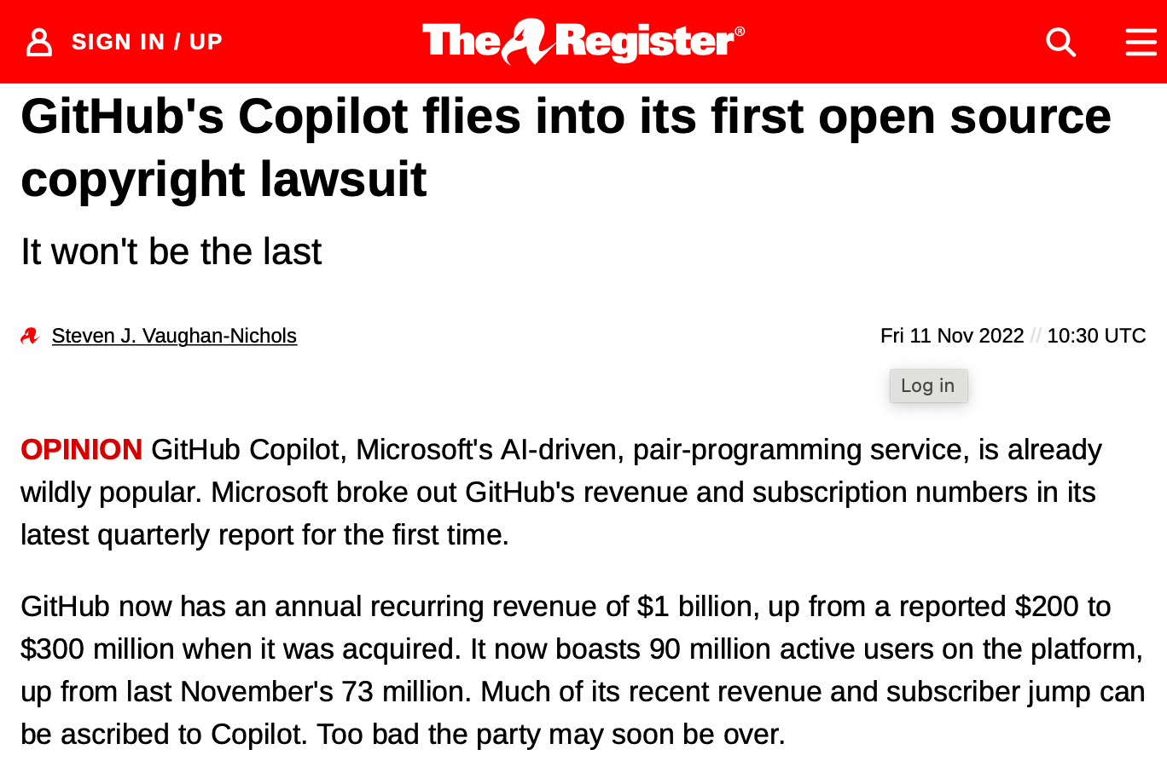
GitHub Copilot + Codex
Codex is a large language model trained on all code in public repositories on GitHub
Copilot suggests lines of code as you program, based on the Codex model
Copilot will output entire snippets of code from public GitHub repositories
What is the ownership and license compatibility of the resulting code?
https://www.theregister.com/2022/11/11/githubs_copilot_opinion/
Notes:
MS’ defense is that this is “fair use” under copyright law… if it is, it will set quite the precedent for copyright of software.

Slide 28
Review: Learning Objectives for this Lesson
You should now be able to…
Understand the terminology “free software” and explain open source culture and principles.
Express an educated opinion on the philosophical/political debate between open source and proprietary principles.
Reason about the tradeoffs of different open source licenses and business model

